Slide 1
HackedDB*: All your database are belong to us * HackedDB is not a real db ☺
#novacodecamp
David Makogon, Microsoft
twitter: @dmakogon, blog: dmak.io

Slide 2





Slide 3


Who am I??? (hint: → David Makogon)
Azure architect
Camera carrier
Pun penner
NoSQL non-novice
Community congrat collector
- (World's first former) Azure MVP
- (Former) MongoDB Master
- Neo4j Ambassador
The stenographer was convicted of a crime, but received a shortened sentence...

Slide 4



Slide 5
For your architect-hat-covered brain today:
Setting the stage
Un-hackable-ing databases
What this isn't about (but still important)
Your own passwords
Your personal data being hacked somewhere else

Slide 6
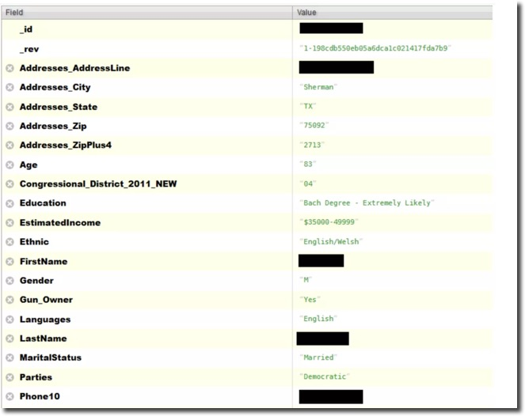


So much data, so much taken!

Slide 7
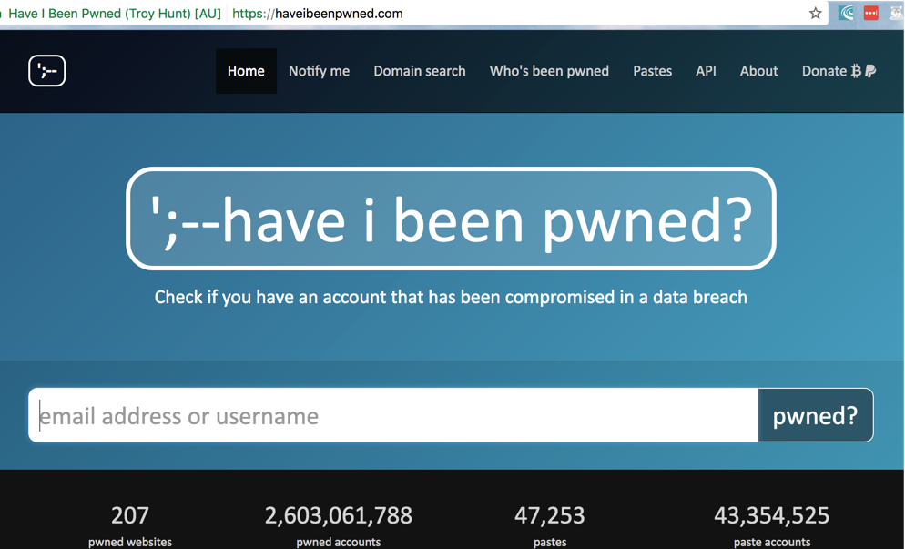
Your data will be...
Deleted
Held for ransom
Sold

Slide 8
Today's focus: LOCKDOWN
How will you, as DB owner, avoid hackage?
We'll look at LOW HANGING FRUIT!
Database security
Virtual networks
IP whitelisting
Jumpbox

Slide 9





But first: our fictitious setup
DB
Web app
Storage

Slide 10
Oh – let's see our hacked database

Slide 11
Out-of-the-box database security
Auth
Network binding

Slide 12
Demo – MongoDB config

Slide 13
Virtual Networks
DB
Storage

Slide 14
Virtual Networks
App server talks to db
app & db server live in vnet
no ports exposed for db
app server has only open port
443

Slide 15
Demo – Virtual Networks

Slide 16
Jump box
22 3389
DB
Storage

Slide 17
Demo – Jumpbox

Slide 18

IP whitelisting
DB
Storage

Slide 19
Demo – IP Whitelisting

Slide 20
Sooo... are we un-hackable yet?
Database security
Virtual networks
IP whitelisting
Jumpbox

Slide 21
Questions?
Twitter: @dmakogon
Blog: dmak.io
Facebook: facebook.com/dmak.online
StackOverflow: david-makogon
Azure stuff at Azure.com
Talk stuff at github.com/dmakogon/novacc2017

